Slide 1

Just Noticeable Difference for Detection of Frequency Boosts and Cuts under Loudspeaker and Headphone Conditions
Kevin Worley and Forrest Kimbrough

Slide 2

What’s the deal with this study?
Focus- To find out if there is a difference in ability to detect boosts and cuts in Headphones vs Loudspeakers at various frequencies.
Research Questions
1. Is there a JND in a listener’s ability to perform an audio task (identifying cuts and boosts) between the loudspeaker and headphone environments?
2. Is there a difference in people’s ability to correctly identify boosts vs. cuts?
3. Where does the threshold lie for a listener’s ability to hear and identify the level of boosts and cuts at various frequencies within samples of pink noise?

Slide 3

Why should we care????
`1. Why is detecting cuts and boosts relevant?
  Frequency detection is important in audio engineering because it helps to ensure accurate and faithful reproduction of sound across the entire frequency range, which is essential for achieving high-quality sound in headphones and loudspeakers.
  Ability to ID Boosts/Cuts=Better sense of the frequency spectrum when listening to music
2. $$$ difference between HP’s and LSP’s; is one better or worse than another for someone interested in having a home studio?
  Knowing whether or not there is a difference between the two conditions could aid audio engineers in their choice of environment to invest in for their mixing and mastering.
3. More and more consumers are trending towards listening using HP’s in day to day life; are consumers losing anything perceptually with that trend?

Slide 4
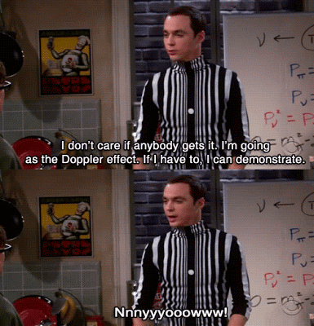
Our Hypotheses
Null Hypothesis(ø)˜-Using the same sound tests on both loudspeakers and headphones, there is not a significant difference in how well they can hear frequencies.
Hypothesis-Using the same sound tests on both loudspeakers and headphones, participants will identify the boost or cuts significantly better with headphones over loudspeakers.

Slide 5
Our Variables of Interest
Independent Variable
  HP vs. Loudspeaker
  EQ Boost and Cuts in the following frequencies of a pink noise sample: 1kHz, 500Hz, 250Hz.
  dB level Boost and Cuts of 2, 4, 6, 8 dB
Dependent Variable
  Participant Response(correct/incorrect)-Binomial Data
How did we analyze our data?
  Non-parametric ANOVA to compare data
  Wilcoxon Matched Paired Test ( Non-parametric T-Test) for compare data
  Descriptive Statistic Test to gather averages

Slide 6
Our Stimuli
For our Stimuli:
Participants heard two bursts of pink noise per trial, the first was the reference with no attenuation, and the second one was changed based on a boost or cut at a given frequency.
Frequencies altered: 1kHz(high), 500 Hz(mid), 250 Hz(low).
For the selected frequencies, each were boosted or cut by 0(control), 2, 4, 6, 8 dB.
30 samples in all were created; the samples were presented to the participants in a random order per set.
5 Sets in all were presented.

Slide 7
What was the Procedure of our Listening Test?
Subjects were asked to file into the anechoic chamber, and take a seat.
Each subject was given a clipboard with a stack of scantrons and were asked to bubble in their name, side number (1 or 2), and Set number for each scantron.
The subjects were asked to identify what they thought the dB level of the Boost or Cut was with the following choices:
A) 0dB B) 2dB, C) 4dB, D) 6dB, E) 8dB
PARTICIPANTS DID NOT NEED TO IDENTIFY FREQUENCY
In order to eliminate as much bias as possible, the participants went back and forth every 15 trials between the headphone and loudspeaker conditions (decided based on what side of the room the subject was sitting as to where they started; taking breaks every 15 trials).
Each subject performed this task a total of 150 times in the various conditions.

Slide 8
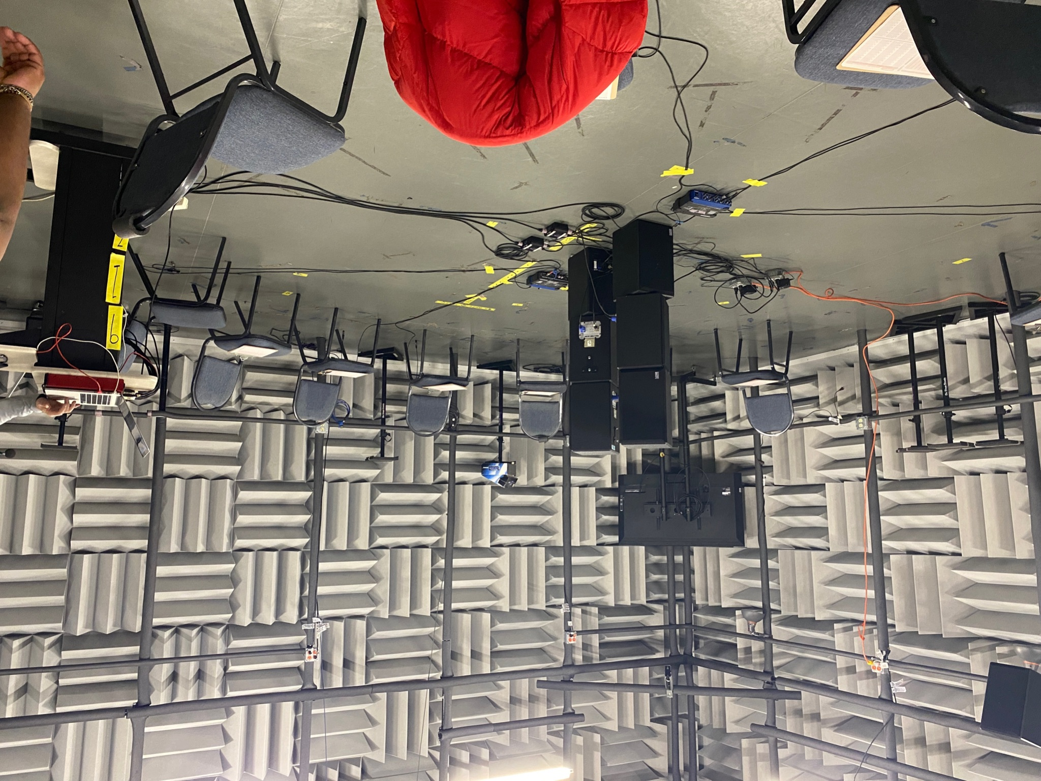

Slide 9
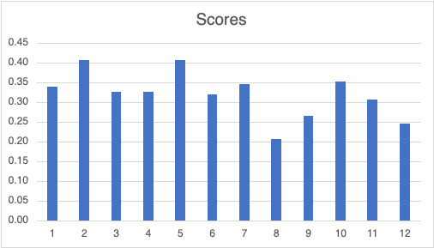
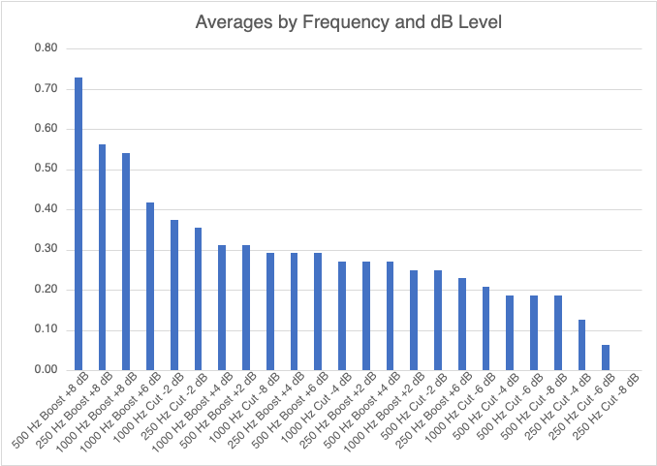
Initial Takeaways
`1. We are not very good at it! :(
2. Appears people seem to perform better with boosts than cuts (but is it significant?).
3. Did we find a threshold in the data for human performance of the task based on these performance averages? (not sure)
4. What about HP vs LSP?

Slide 10
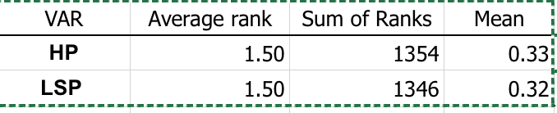
Headphones vs. Loudspeaker?
Boost vs. Cut?
BACK TO THE CHART
Question 1) Is there a difference between Headphones and Loudspeakers for frequency detection?
With the data collected from the experiment it was determined that that there was no difference between Headphones and Loudspeakers.
We ran an ANOVA, and it was determined that there was no significant difference between Headphones and Loudspeakers (X2 = .07, n = 900, p = .73).
Question 2) Were the participant better with detecting boost or cuts in frequencies?
Using the same type of ANOVA Test as before, we determined that participants did perform significantly better with detecting Boost(M = 0.36) versus detecting Cuts(0.21), (n = 360, p < .001). Take out extra chart.

Slide 11
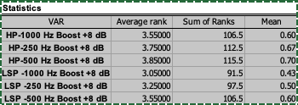
Threshold
After observing the chart below we decided to compare the top three scores to one another since all three average scores were above 50%.
We ran an ANOVA comparing headphones and loudspeakers based on the top three scores which were all +8dB stimuli.
We found that using the data from the top three frequency and dB levels, headphones and loudspeakers performed the best at 500 Hz Boost +8dB.
Headphones also performed slightly better than Loudspeakers (p=.056).
Where does the threshold lie for a listener’s ability to hear and identify the level of boosts and cuts at various frequencies within samples of pink noise?

Slide 12
Threshold Cont.
We continued to further compare the top 3 Scores in the Chart Below with each other.
Using Wilcoxon Paired Tests, it was determined that…
1kHz Boost +8dB vs 1kHz Boost +6dB : Not significant (p>0.05)
250 Hz Boost +8dB vs 1kHz Boost +8dB : Not significant (p>0.05)
500 Hz Boost +8dB vs 250 Hz Boost +8dB : Not significant (p>0.05)
Where does the threshold lie for a listener’s ability to hear and identify the level of boosts and cuts at various frequencies within samples of pink noise?

Slide 13
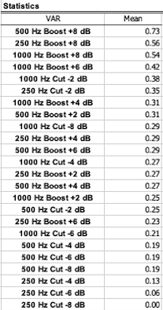
Threshold cont…
o With those results we began to develop a sense of where the threshold may lie…
Even though the data shows no significance when comparing the data to one another, we assume based on the drastic jump in score between 500 Hz Boost +8dB and the rest of the top scores that this may be the threshold for running this experiment.
  With this newly placed threshold set, we decided to compare Headphone and Loudspeaker using a Wilcoxon Paired Test.
    When comparing Headphone and Loudspeaker with a 8dB boost at 500Hz, we found that there is still no significant difference between the two (Z = -0.6, n = 29, p > .05).

Slide 14
Discussion and Conclusion
With the results gathered, we were able to answer our research questions.
What do they suggest about the perception of audio?
  As far as frequency detection goes, it is clear that participants could better identify Boosts over Cuts. Whether or not they were wearing headphones or listening through loudspeakers made little to no difference on that result.
How can this help audio engineering?
  This research can help in ways of helping beginners making more informed decisions purchasing audio equipment.
  Supports the argument that you can get just as good of a sense mixing in either of the two environments; at least frequency detection wise(same principle would seem to apply for general music listening consumers as well).

Slide 15
Future Research
Limitations of our design
  1. Structure of the Question(using a 5 choice scale vs. same or different scale)
  2. Did the Chairs move?? *Give the reasoning behind this statement*
  3. Uneven distribution of HP vs. LSP data points(occuring in randomization of trials)
Ways this research could have been improved or continued with more research
  1. Having a better idea of a threshold for the experiment.
  2. Using specific groups
  3. Prior training
  4. Testing using more of a same/different model to hopefully gain higher accuracy scores to compare.
  5. HP vs. LSP on detecting distortion, reverb, spacial, etc.

Slide 16
Bibliography
[1] V. Koehl, M. Paquier and S. Delikaris-Manias, "Comparison of Subjective Assessments Obtained from Listening Tests through Headphones and Loudspeaker Setups," in Journal of Audio Engineering Society Paper 8560, October 2011.
[2] R. King, B. Leonard and G. Sokora, "Loudspeakers and Headphones: The Effects on Playback Systems of Listening Test Subjects," in The Journal of the Acoustical Society of America , Montreal, Canada DOI: 10.1121/1.4799550, June. 2-7 2013.
[3] S. Flanagan, C. B. Moore and M. A. Stone, "Discrimination of Group Delay in Click-like Signals Presented via Headphones and Loudspeakers," Journal of Audio Engineering Society, vol. 53, no. 7-8, pp. 593-611, July 2005.
[4] B. Bauer, "Stereophonic Earphones and Binaural Loudspeakers," Journal of Audio Engineering Society, vol. 9, no. 2, pp. 148-151, April 1961.
[5] J. Berg, T. Johannesson, M. Löfdahl and A. Nykanen, "In-Ear vs. Loudspeaker Monitoring for Live Sound and the Effect on Audio Quality Attributed and Musical Performance," in Advances in Fundamental and Applied Research on Spatial Audio Doi: 10.5772/intechopen.10485, May 2017.
[6] T. Cox, P. D'Antonio and M. R. Avis, ""Room Sizing and Optimization at Low Frequencies," Journal of Audio Engineering Society, vol. 52, no. 6, pp. 640-651, June 2004.
[7] S. Guttenburg, "What's more accurate: Speakers or Headphones," C-Net Productions, 16 April 2016. [Online]. Available: https://www.cnet.com/tech/mobile/whats-more-accurate-speakers-or-headphones/. [Accessed 25 February 2023].
[8] M. Mizumachi, R. Yamamoto and K. Niyada, "Subjective Evaluation of High Resolution Audio through Headphones," in Journal of Audio Engineering Society Paper 9529, May 2016.

